Slide 1
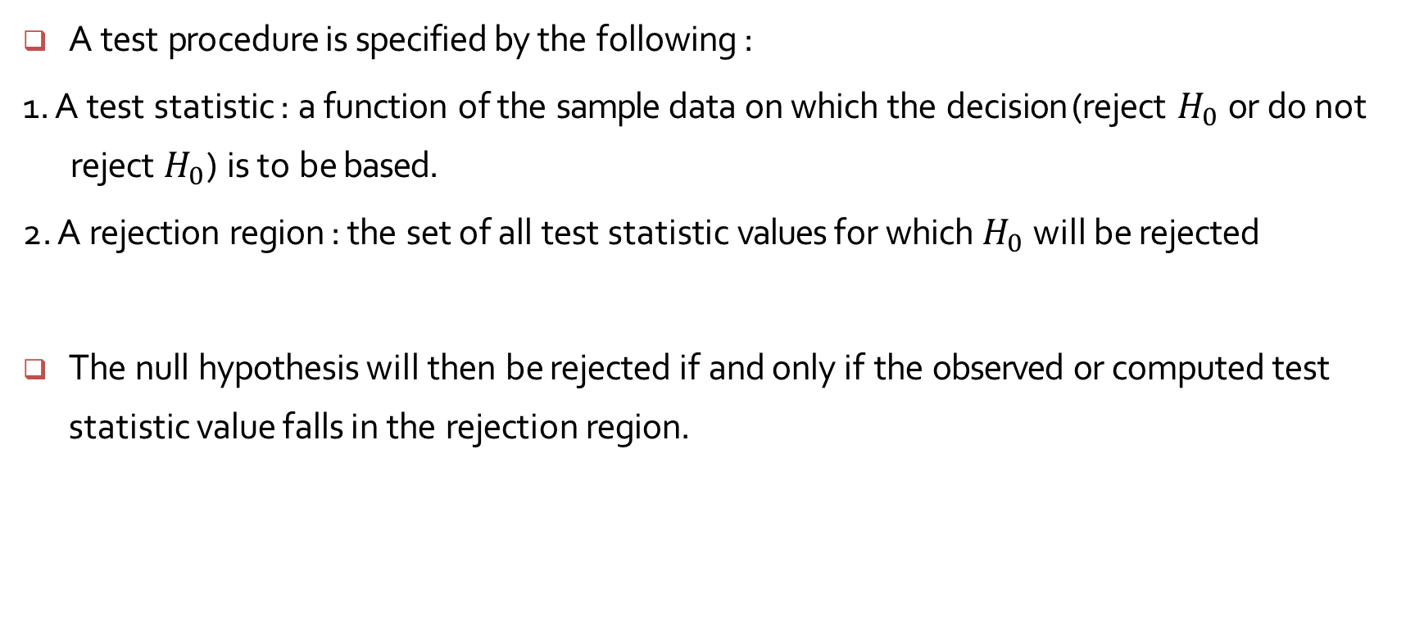
Test Procedures
A test procedure is specified by the following :
1. A test statistic : a function of the sample data on which the decision (reject $H_{0}$ or do not reject $H_{0}$) is to be based.
2. A rejection region : the set of all test statistic values for which $H_{0}$ will be rejected
The null hypothesis will then be rejected if and only if the observed or computed test statistic value falls in the rejection region.

Slide 2
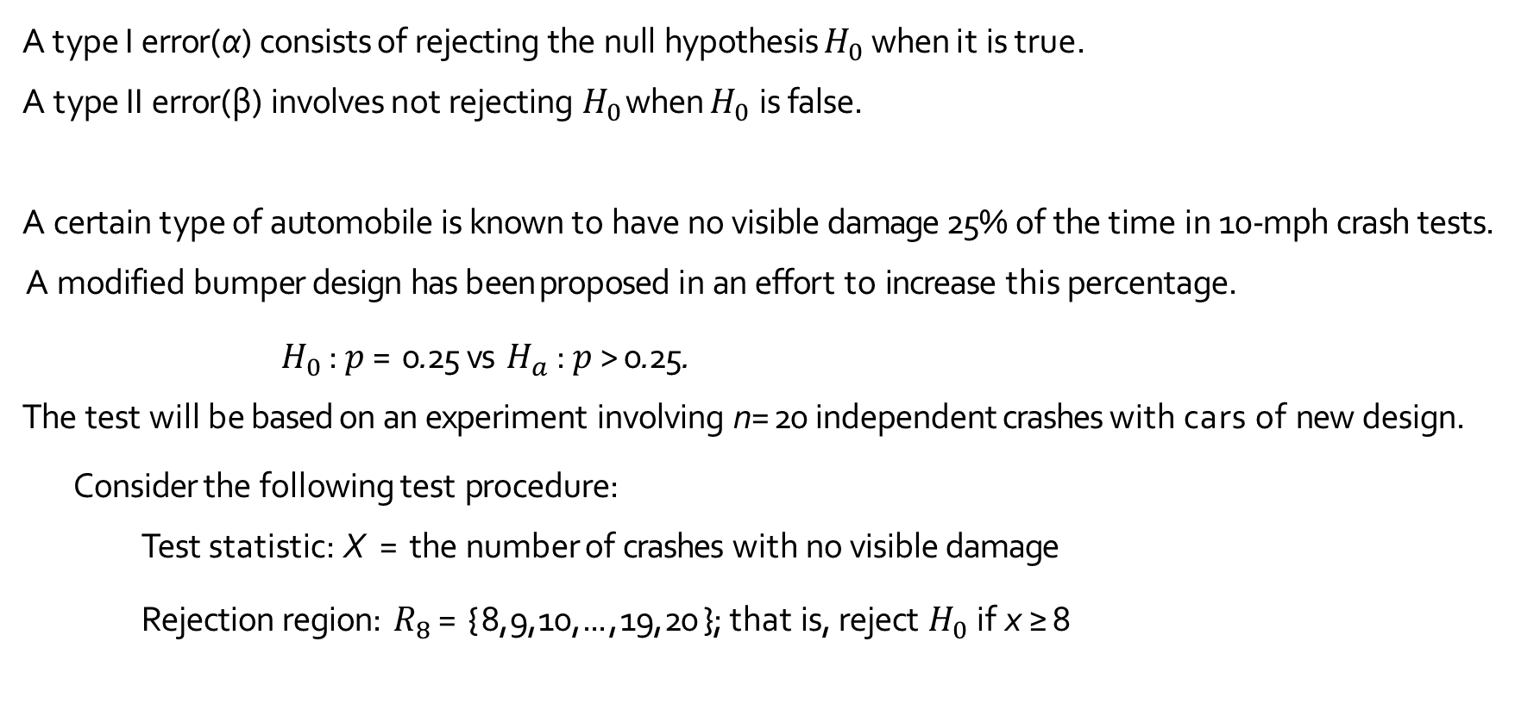
Errors in Hypothesis Testing : Example 8.1
A type I error(α) consists of rejecting the null hypothesis $H_{0}$ when it is true.
A type II error(β) involves not rejecting $H_{0}$ when $H_{0}$ is false.
A certain type of automobile is known to have no visible damage 25% of the time in 10-mph crash tests.
A modified bumper design has been proposed in an effort to increase this percentage.
$H_{0}$ : $p$ = 0.25 vs $H_{a}$ : $p$ > 0.25.
The test will be based on an experiment involving n=20 independent crashes with cars of new design.
Consider the following test procedure:
Test statistic: X = the number of crashes with no visible damage
Rejection region: $R_{8}$ = { 8, 9, 10, ... , 19, 20 }; that is, reject $H_{0}$ if x ≥ 8

Slide 3
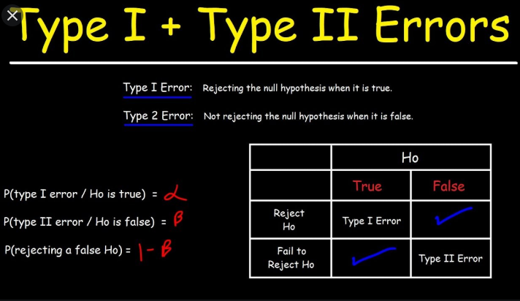

Slide 4
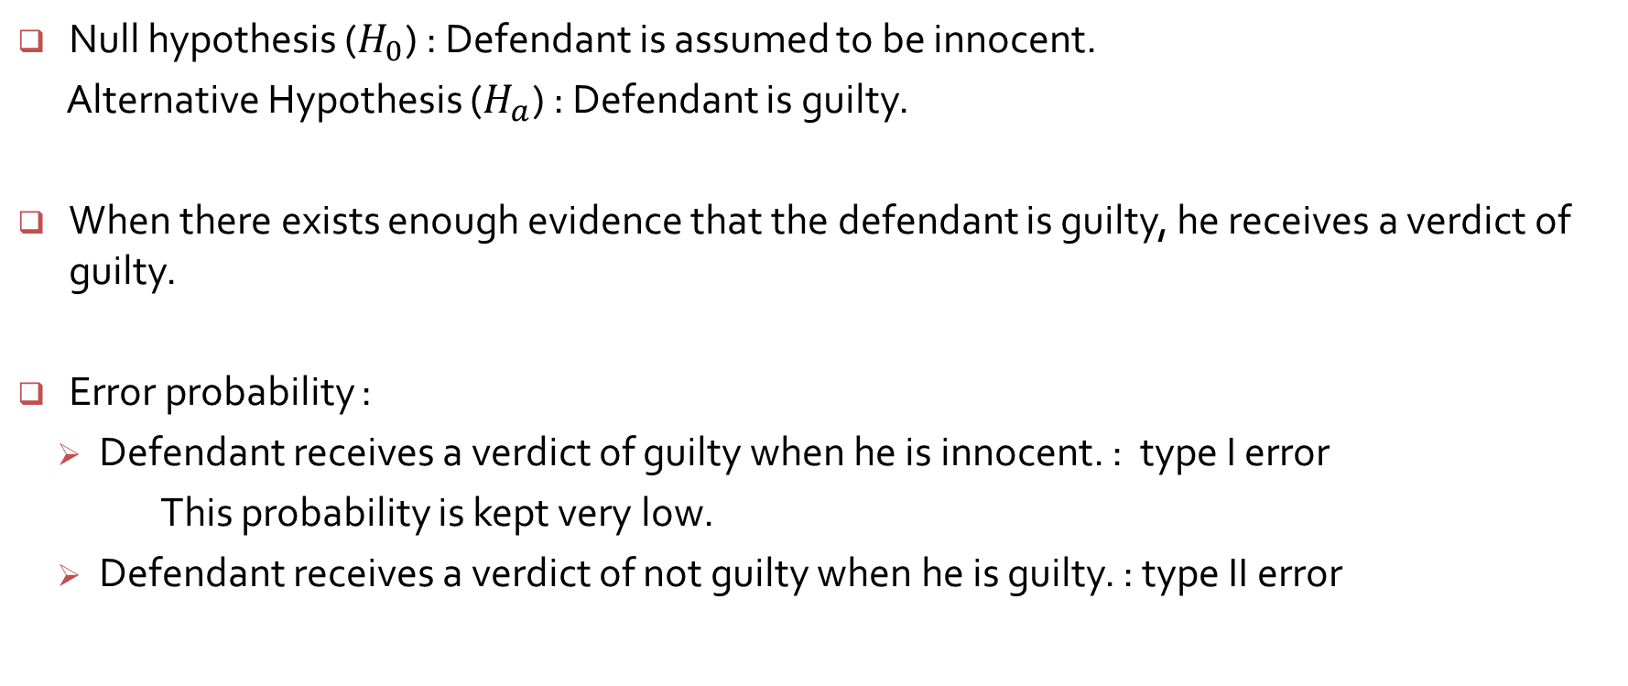
Court example
Null hypothesis ($H_{0}$) : Defendant is assumed to be innocent.
Alternative Hypothesis ($H_{a}$) : Defendant is guilty.
When there exists enough evidence that the defendant is guilty, he receives a verdict of guilty.
Error probability :
Defendant receives a verdict of guilty when he is innocent. : type I error
This probability is kept very low.
Defendant receives a verdict of not guilty when he is guilty. : type II error

Slide 5
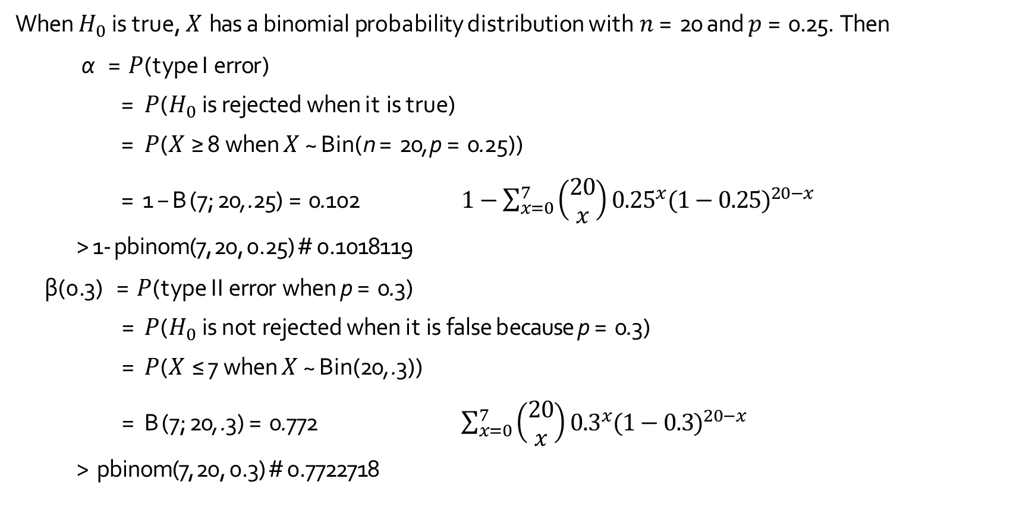
Errors in Hypothesis Testing
When $H_{0}$ is true, $X$ has a binomial probability distribution with $n$ = 20 and $p$ = 0.25. Then
α = $P$(type I error)
= $P$($H_{0}$ is rejected when it is true)
= $P$($X$ ≥ 8 when $X$ ~ Bin(n = 20, p = 0.25))
= 1 − B(7; 20, .25) = 0.102 $1−\sum_{x=0}^{7}{\left(\begin{matrix}20 \\ x\end{matrix}\right)}{0.25}^{x}{(1−0.25)}^{20−x}$
> 1- pbinom(7, 20, 0.25) # 0.1018119
β(0.3) = $P$(type II error when p = 0.3)
= $P$($H_{0}$ is not rejected when it is false because p = 0.3)
= $P$($X$ ≤ 7 when $X$ ~ Bin(20, .3))
= B(7; 20, .3) = 0.772 $\sum_{x=0}^{7}{\left(\begin{matrix}20 \\ x\end{matrix}\right)}{0.3}^{x}{(1−0.3)}^{20−x}$
> pbinom(7, 20, 0.3) # 0.7722718

Slide 6
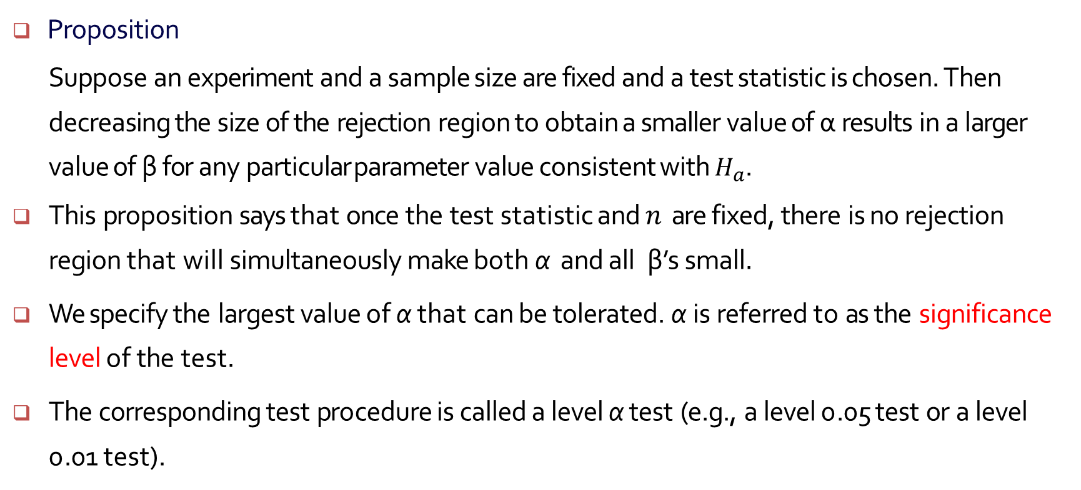
Errors in Hypothesis Testing
Proposition
Suppose an experiment and a sample size are fixed and a test statistic is chosen. Then decreasing the size of the rejection region to obtain a smaller value of α results in a larger value of β for any particular parameter value consistent with $H_{a}$.
This proposition says that once the test statistic and $n$ are fixed, there is no rejection region that will simultaneously make both α and all β’s small.
We specify the largest value of α that can be tolerated. α is referred to as the significance level of the test.
The corresponding test procedure is called a level α test (e.g., a level 0.05 test or a level 0.01 test).

Slide 7
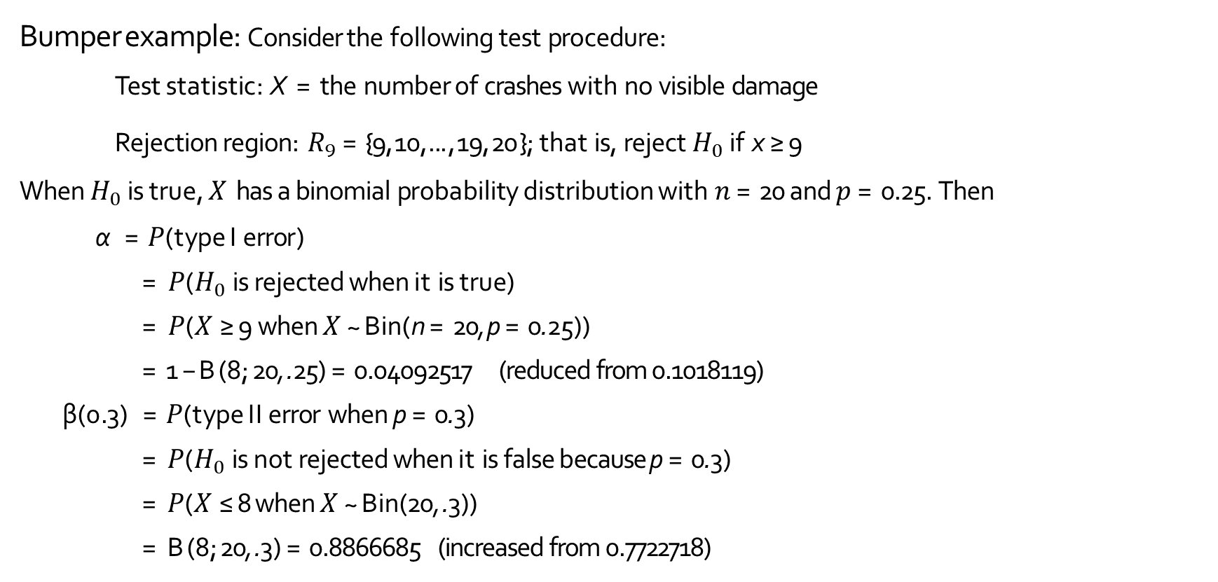
Bumper example: Consider the following test procedure:
Test statistic: X = the number of crashes with no visible damage
Rejection region: $R_{9}$ = {9, 10, ... , 19, 20 }; that is, reject $H_{0}$ if x ≥ 9
When $H_{0}$ is true, $X$ has a binomial probability distribution with $n$ = 20 and $p$ = 0.25. Then
α = $P$(type I error)
= $P$($H_{0}$ is rejected when it is true)
= $P$($X$ ≥ 9 when $X$ ~ Bin(n = 20, p = 0.25))
= 1 − B(8; 20, .25) = 0.04092517 (reduced from 0.1018119)
β(0.3) = $P$(type II error when p = 0.3)
= $P$($H_{0}$ is not rejected when it is false because p = 0.3)
= $P$($X$ ≤ 8 when $X$ ~ Bin(20, .3))
= B(8; 20, .3) = 0.8866685 (increased from 0.7722718)

